Slide 1

BU90005GWZ-E2EVK-101 Measurement Report
March 17th, 2014
Hosted by: Xuan Dang

Slide 2
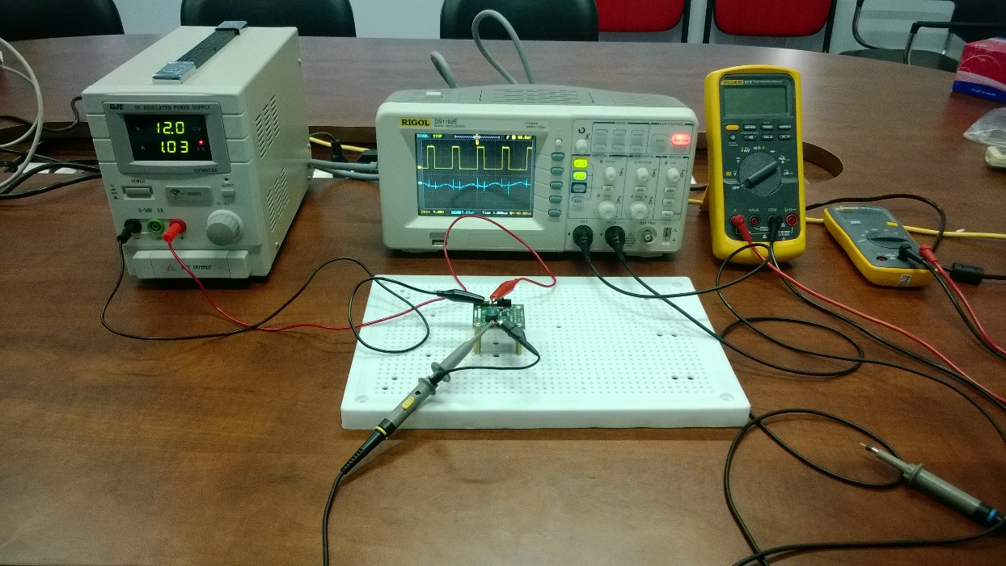
Equipment list
Regulated DC Power Supply
QJE QJ3005XE (0-30V/5A)
Multimeter:
Fluke 87V True RMS
Fluke 106
Oscilloscope
Rigol DS1102E
Electronic Load
B&K BK8500
Current probe
RP1001C

Slide 3
Functional Test
Test case 1 procedure
Turn on the DC Supply. Set output of the DC Supply in range from 2.3V to 5.5V. Turn off the DC Supply. Connect DC Supply to: [+]V_{IN}(TP1) and [-]GND(TP2).
Set position of J2 header(Pin2 connect to Pin3) to select the IC operation mode is Forced PFM.
Connect Electronic Load to: [+]V_{OUT}(TP3) and [-]GND(TP4). Power on Electronic Load, set input of Electronic Load to 100mA and don’t turn on load.
Move J1 header to turn EN on.
Turn on the DC Supply.
Turn on load.
Result:
V_{IN}=2.3V to 2.5V, V_{OUT}=2.25V to 2.45V | V_{IN}=2.5V to 5.5V, V_{OUT}=2.45V to 2.515V
Follow datasheet, Output voltage accuracy is -2%/+3% (-0.05V/+0.075V).
Test passed.

Slide 4
Functional Test (cont.)
Test case 2 procedure
Turn on the DC Supply. Set output of the DC Supply in range from 2.3V to 5.5V. Turn off the DC Supply. Connect DC Supply to: [+]V_{IN}(TP1) and [-]GND(TP2).
Set position of J2 header(Pin2 connect to Pin1) to select the IC operation mode is Forced PWM.
Connect Electronic Load to: [+]V_{OUT}(TP3) and [-]GND(TP4). Power on Electronic Load, set input of Electronic Load to 1A and don’t turn on load.
Move J1 header to turn EN on.
Turn on the DC Supply.
Turn on load.
Result:
V_{IN}=2.3V to 3V, V_{OUT}= 1.6V to 2.49V | V_{IN}=3V to 5.5V, V_{OUT}=2.49V
Follow datasheet, Output voltage accuracy is ±2% (±0.05V).
Test passed.

Slide 5
Functional Test (cont.)
Test case 3 procedure
After implement test case 1, the IC operate properly.
Move J1 header to turn EN off.
Move J1 header to turn EN on.
Result:
V_{IN} = 5V
V_{OUT} = 2.5V/100mA (in Forced PFM Mode)
Test passed.

Slide 6
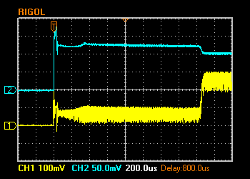
Functional Test (cont.)
Test case 4 procedure
After implement test case 2, the IC operate properly.
Move J1 header to turn EN off.
Move J1 header to turn EN on.
Result:
V_{IN} = 5V.
V_{OUT} = 0.26V/1A (in Forced PWM Mode)
Test failed
I_{OUT} 0.5A/Div. (DC)
V_{OUT} 100mV/Div. (DC)

Slide 7
Functional Test (cont.)
Test case 5 procedure
After implement test case 1, the IC operate properly.
Turn off load.
Turn on load.
Result:
V_{IN}=5V, I_{OUT}=100mA, V_{OUT}=2.5V
Test passed.

Slide 8
Functional Test (cont.)
Test case 6 procedure
After implement test case 2, the IC operate properly.
Turn off load.
Turn on load.
Result:
V_{IN}=5V, I_{OUT}=1A, V_{OUT}=2.48V
Test passed.

Slide 9
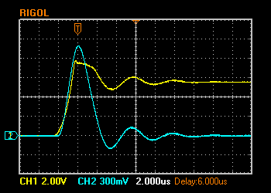
Hot Plugging Test
Test condition
V_{IN} = 5.5V
I_{OUT} = 1A
With original diode D1: P4SMA6.8A
Result:
I_{IN_PEAK}= 13.9A
V_{IN} peak transient voltage (in both modes) is 7.76V > V_{IN} Maximum Rating (7V)
The IC still operate properly after 100+ testing time.
V_{IN} 2V/Div. (DC)
I_{IN} 3A/Div. (AC)

Slide 10
Circuit Quiescent Current Measurement
Test condition
V_{IN} = 0-5.5V
Forced PFM Mode
Room temperature 25ºC

Slide 11
Circuit Quiescent Current Measurement (cont.)
Test condition
V_{IN} = 0-5.5V
Forced PWM Mode
Room temperature 25ºC

Slide 12
Efficiency Measurements
Test condition
V_{IN} = 5V
V_{OUT} = 2.5V
Forced PFM Mode
Room temperature 25ºC

Slide 13
Efficiency Measurements (cont.)
Test condition
V_{IN} = 5V
V_{OUT} = 2.5V
Forced PWM Mode
Room temperature 25ºC

Slide 14
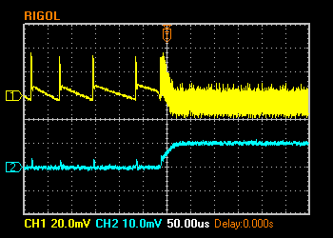
Load Response Measurements
Load response characteristic
(V_{IN}=5V, V_{OUT}=2.5V, I_{OUT}=0 → 100mA, Forced PFM Mode)
V_{OUT} 20mV/Div. (AC)
I_{OUT} 100mA/Div. (DC)

Slide 15
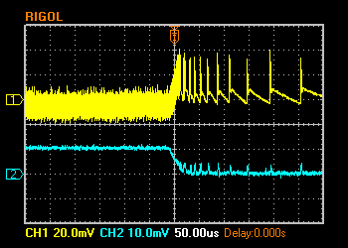
Load Response Measurements (cont.)
Load response characteristic
(V_{IN}=5V, V_{OUT}=2.5V, I_{OUT}=100mA → 0, Forced PFM Mode)
V_{OUT} 20mV/Div. (AC)
I_{OUT} 100mA/Div. (DC)

Slide 16
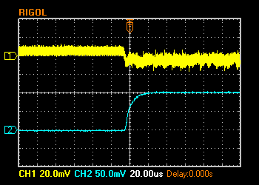
Load Response Measurements (cont.)
Load response characteristic
(V_{IN}=5V, V_{OUT}=2.5V, I_{OUT}=0 → 1A, Forced PWM Mode)
V_{OUT} 20mV/Div. (AC)
I_{OUT} 0.5A/Div. (DC)

Slide 17
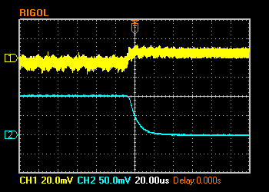
Load Response Measurements (cont.)
Load response characteristic
(V_{IN}=5V, V_{OUT}=2.5V, I_{OUT}=1A → 0, Forced PWM Mode)
V_{OUT} 20mV/Div. (AC)
I_{OUT} 0.5A/Div. (DC)

Slide 18
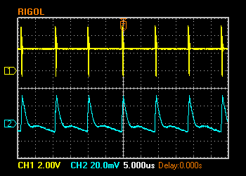
Ripple Response Measurements
V_{OUT} Ripple voltage
(V_{IN}=5V, V_{OUT}=2.5V, I_{OUT}=10mA, Forced PFM Mode)
V_{SW} 2V/Div. (DC)
V_{OUT} 20mV/Div. (AC)

Slide 19
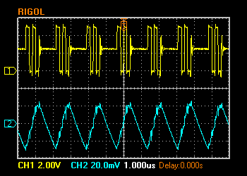
Ripple Response Measurements (cont.)
V_{OUT} Ripple voltage
(V_{IN}=5V, V_{OUT}=2.5V, I_{OUT}=100mA, Forced PFM Mode)
V_{SW} 2V/Div. (DC)
V_{OUT} 20mV/Div. (AC)

Slide 20
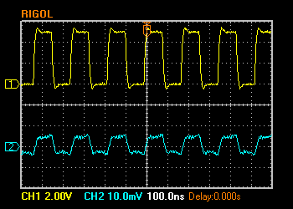
Ripple Response Measurements (cont.)
V_{OUT} Ripple voltage
(V_{IN}=5V, V_{OUT}=2.5V, I_{OUT}=0A, Forced PWM Mode)
V_{SW} 2V/Div. (DC)
V_{OUT} 10mV/Div. (AC)

Slide 21
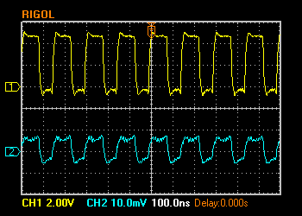
Ripple Response Measurements (cont.)
V_{OUT} Ripple voltage
(V_{IN}=5V, V_{OUT}=2.5V, I_{OUT}=1A, Forced PWM Mode)
V_{SW} 2V/Div. (DC)
V_{OUT} 10mV/Div. (AC)

Slide 22
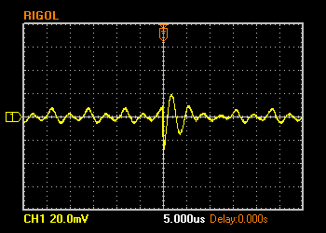
Input Voltage Ripple Measurements
V_{IN} Ripple voltage
(V_{IN}=5V, V_{OUT}=2.5V, C_{IN}=4.7uF + 0.1uF, I_{OUT}=0A, Forced PFM Mode)
V_{IN} 20mV/Div. (AC)

Slide 23
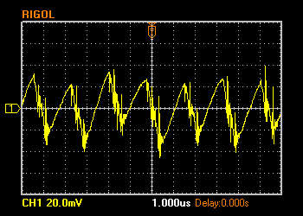
Input Voltage Ripple Measurements (cont.)
V_{IN} Ripple voltage
(V_{IN}=5V, V_{OUT}=2.5V, C_{IN}=4.7uF + 0.1uF, I_{OUT}=1A, Forced PFM Mode)
V_{IN} 20mV/Div. (AC)

Slide 24
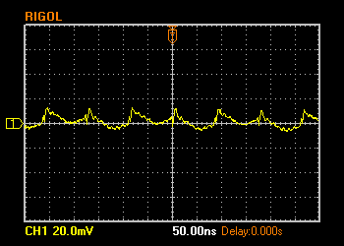
Input Voltage Ripple Measurements (cont.)
V_{IN} Ripple voltage
(V_{IN}=5V, V_{OUT}=2.5V, C_{IN}=4.7uF + 0.1uF, I_{OUT}=0A, Forced PWM Mode)
V_{IN} 20mV/Div. (AC)

Slide 25
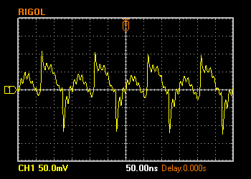
Input Voltage Ripple Measurements (cont.)
V_{IN} Ripple voltage
(V_{IN}=5V, V_{OUT}=2.5V, C_{IN}=4.7uF + 0.1uF, I_{OUT}=1A, Forced PWM Mode)
V_{IN} 50mV/Div. (AC)

